Slide 1


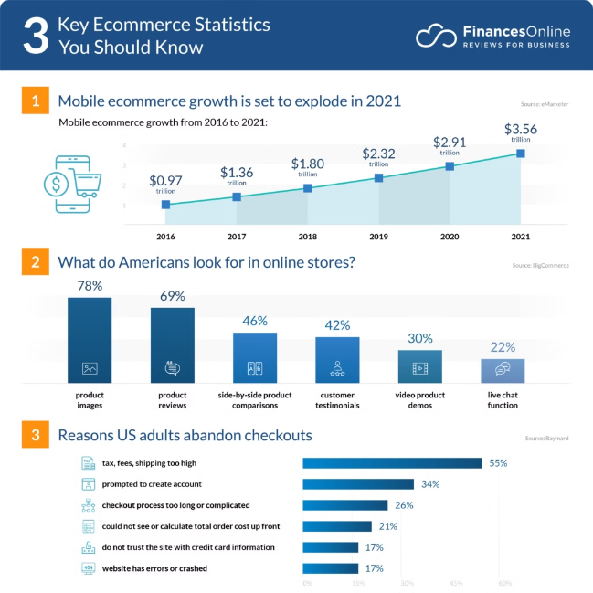
A Traffic Tracking and Analysis Model for Effective E-commerce Management
The proliferation of e-commerce has underscored the critical importance of understanding consumer behavior to drive business growth and profitability. This presentation outlines a comprehensive traffic tracking and analysis model tailored to the e-commerce domain, empowering businesses to optimize their strategies, enhance customer satisfaction, and achieve revenue growth.

Slide 2


Overcoming the Challenge of Extracting Insights from User Data
1
Data Collection Hurdles
E-commerce businesses face an overwhelming amount of user data, making it increasingly challenging to extract valuable insights.
2
Limited Customer Understanding
Businesses struggle to comprehend customer preferences and purchasing patterns, hindering their ability to make data-driven decisions.
3
Missed Opportunities
The inability to effectively analyze user data prevents e-commerce companies from capitalizing on growth opportunities.

Slide 3
A Tailored Solution for E-commerce Traffic Tracking and Analysis
Comprehensive Data Collection
Advanced Data Analysis
Actionable Insights
Leveraging techniques such as user segmentation, customer journey mapping, and predictive modeling to uncover hidden patterns and trends.
Real-time insights to inform data-driven decision-making and optimization of e-commerce strategies.
Meticulous collection, processing, and analysis of user data through web analytics tools and custom tracking mechanisms.

Slide 4

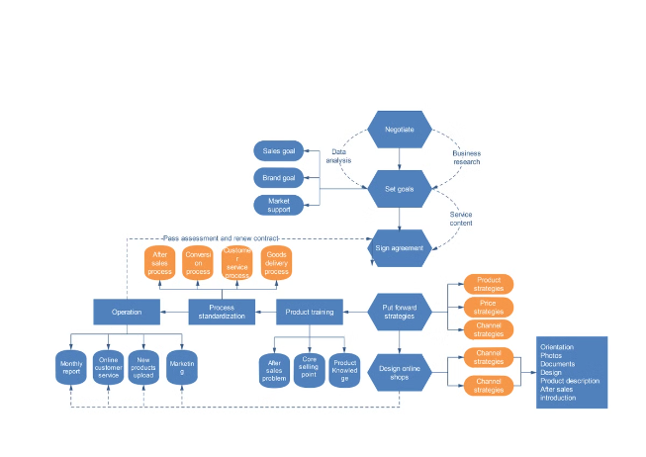
Rigorous Methodology for Effective Traffic Tracking and Analysis
1
Data Collection
Leveraging web analytics tools and custom tracking mechanisms to capture comprehensive user data.
2
Data Preprocessing
Rigorous data cleaning and preprocessing to ensure data quality and integrity.
3
Advanced Analysis
Applying state-of-the-art data analysis techniques to uncover insights and trends.

Slide 5

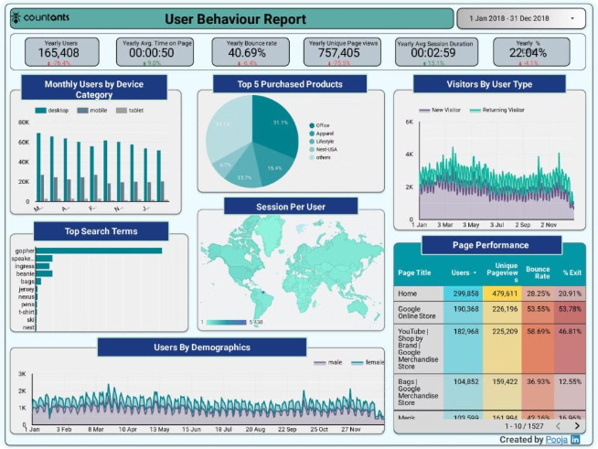
Uncovering Insights through Advanced Data Analysis Techniques
User Segmentation
Grouping customers based on shared characteristics to tailor marketing and personalization strategies.
Customer Journey Mapping
Analyzing customer interactions and touchpoints to optimize the customer experience.
Predictive Modeling
Forecasting customer behavior and trends to anticipate and respond to market changes.

Slide 6

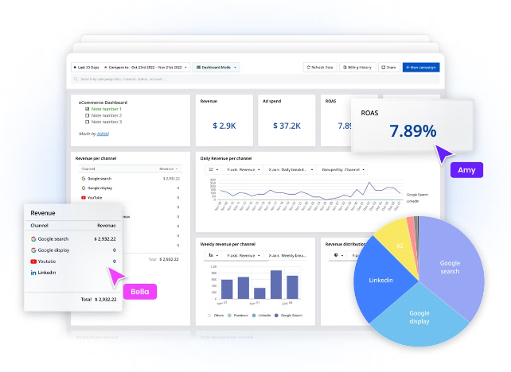
Measuring the Impact: Key Performance Indicators (KPIs)
Conversion Rates
Capturing the effectiveness of marketing and sales strategies.
Customer Retention
Evaluating the ability to retain and build long-term relationships with customers.
Revenue Growth
Assessing the model's impact on the business's financial performance.

Slide 7

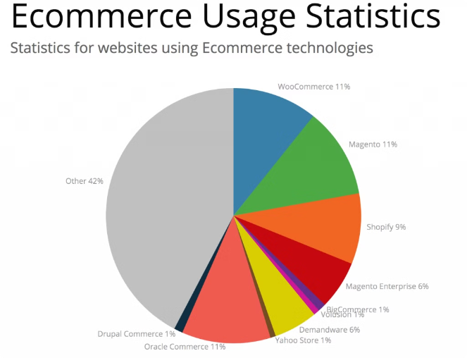



Unlocking the Benefits of Optimized E-commerce Management
Enhanced Customer Satisfaction
Tailored experiences and improved service based on deeper customer understanding.
Informed Decision-Making
Real-time insights to support strategic business decisions and optimization.
Increased Revenue Growth
Driving profitability through effective marketing, sales, and customer retention strategies.

Slide 8

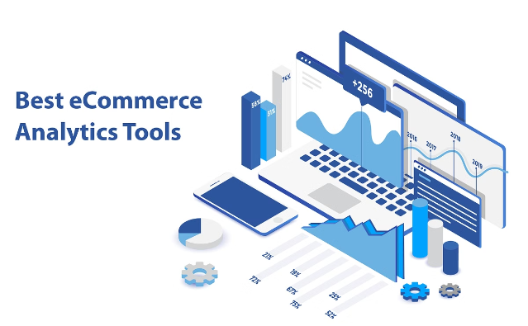
Conclusion: Elevating E-commerce Performance through Data-driven Insights
This presentation has outlined a comprehensive traffic tracking and analysis model tailored for the e-commerce domain. By leveraging advanced data analysis techniques, businesses can unlock a deeper understanding of customer behavior, optimize their strategies, enhance customer satisfaction, and drive sustainable revenue growth.

